Slide 1
Data Structures
Lists
Using lists as Stack and Queue
List Comprehension
Tuples
Sets
Dictionaries
Examples and Practice Questions

Slide 2
What is Data Structure?
Organizing, managing and storing data is important as it enables easier access and efficient modifications. Data Structures allows you to organize your data in such a way that enables you to store collections of data, relate them and perform operations on them accordingly.
Python has implicit support for Data Structures which enable you to store and access data. These structures are called List, Dictionary, Tuple and Set.
LISTS:
Lists are used to store data of different data types in a sequential manner. There are addresses assigned to every element of the list, which is called as Index. The index value starts from 0 and goes on until the last element called the positive index. There is also negative indexing which starts from -1 enabling you to access elements from the last to first. Let us now understand lists better with the help of an example program.
List is a collection which is ordered and changeable. Allows duplicate members.

Slide 3
LIST functions
append() | Adds an element at the end of the list
clear() | Removes all the elements from the list
copy() | Returns a copy of the list
count() | Returns the number of elements with the specified value
extend() | Add the elements of a list (or any iterable), to the end of the current list
index() | Returns the index of the first element with the specified value
insert() | Adds an element at the specified position
pop() | Removes the element at the specified position
remove() | Removes the item with the specified value
reverse() | Reverses the order of the list
sort() | Sorts the list

Slide 4
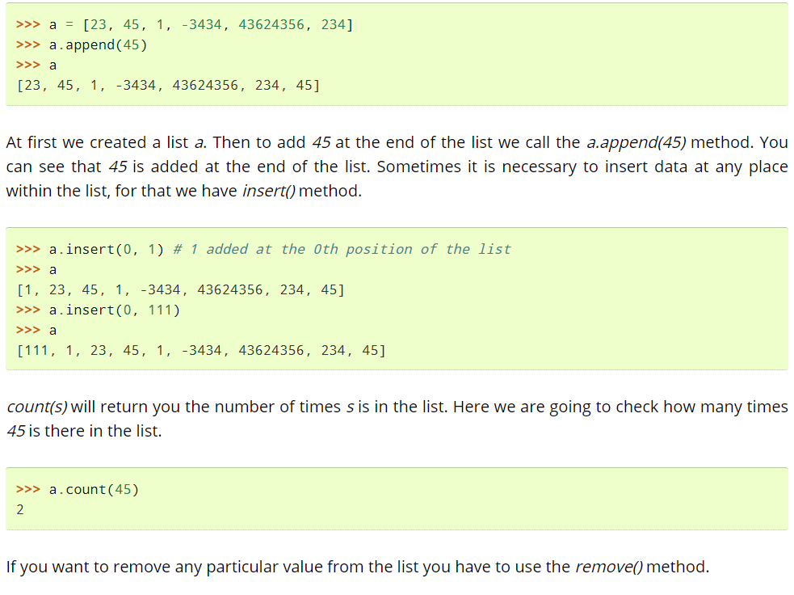
LISTS

Slide 5
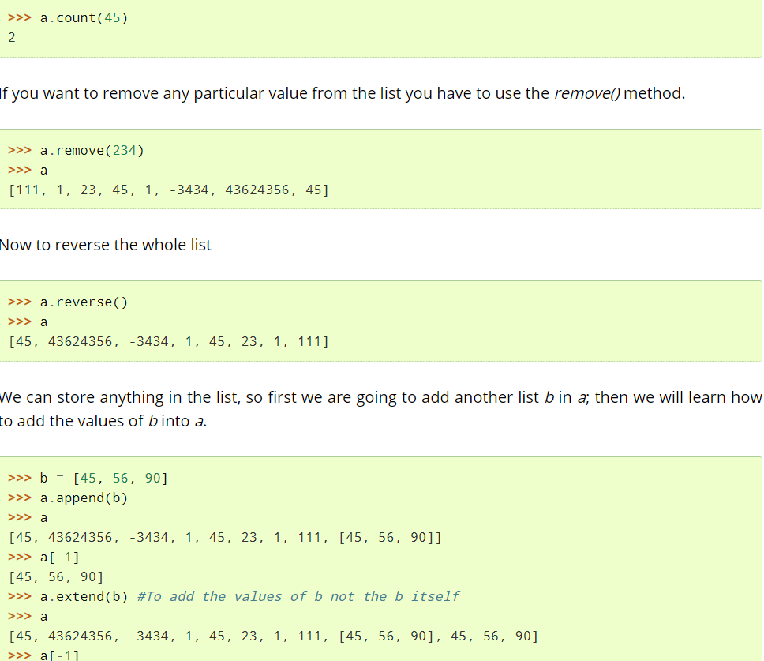
List Operator

Slide 6
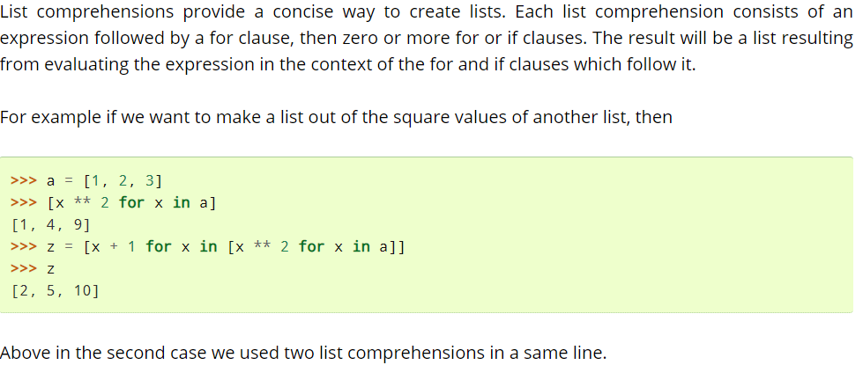
List Comprehension
https://thomas-cokelaer.info/tutorials/python/lists.html

Slide 7
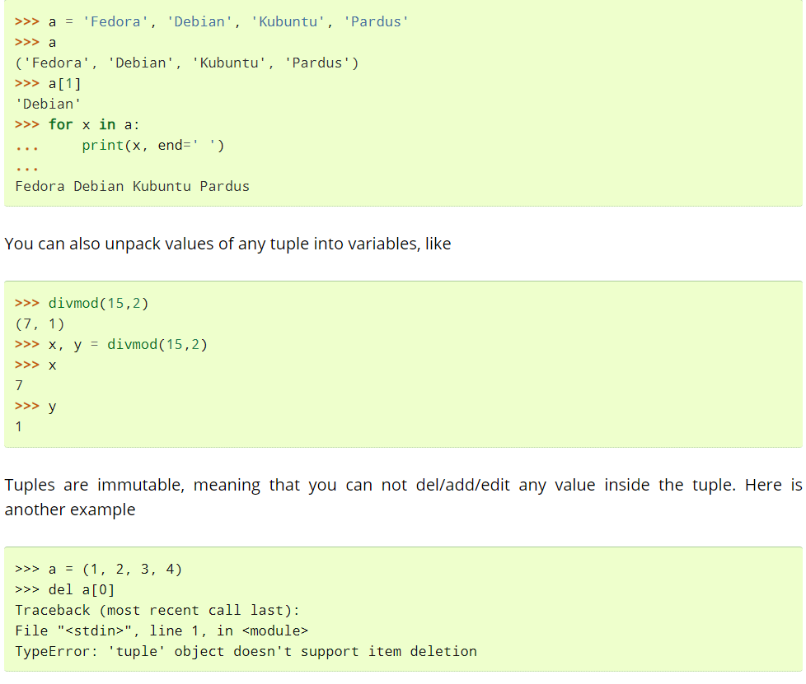
Tuples
Tuples are the same as lists are with the exception that the data once entered into the tuple cannot be changed no matter what. The only exception is when the data inside the tuple is mutable, only then the tuple data can be changed. The example program will help you understand better.

Slide 8
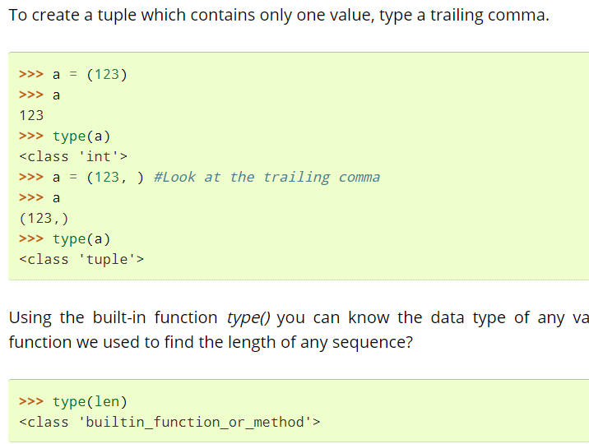
Tuples
Convertí list to tuples
x = ("apple", "banana", "cherry") y = list(x) y[1] = "kiwi" x = tuple(y) print(x)
You cannot add or remove any values in tuple because the values are unchangeable.

Slide 9
Sets
A set is a collection which is unordered and unindexed. In Python sets are written with curly brackets.
thisset = {"apple", "banana", "cherry"} print(thisset)
Sets are a collection of unordered elements that are unique. Meaning that even if the data is repeated more than one time, it would be entered into the set only once. It resembles the sets that you have learnt in arithmetic. The operations also are the same as is with the arithmetic sets. An example program would help you understand better.
missed = {1, 2, 3, 4}
my_set_2 = {3, 4, 5, 6}
print(my_set.union(my_set_2), '----------', my_set | my_set_2)
print(my_set.intersection(my_set_2), '----------', my_set & my_set_2)
print(my_set.difference(my_set_2), '----------', my_set - my_set_2)
print(my_set.symmetric_difference(my_set_2), '----------', my_set ^ my_set_2)
my_set.clear()
print(my_set)
Arrays vs. Lists
Arrays and lists are the same structure with one difference. Lists allow heterogeneous data element storage whereas Arrays allow only homogenous elements to be stored within them.

Slide 10
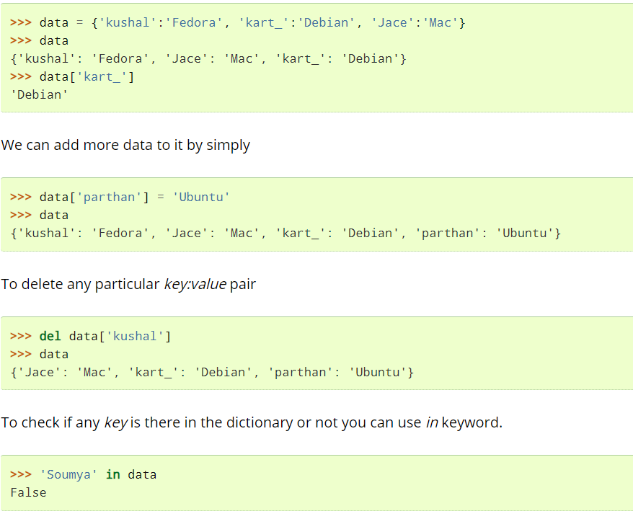
Dictionaries
Dictionaries are unordered set of key: value pairs where keys are unique. We declare dictionaries using {} braces. We use dictionaries to store data for any particular key and then retrieve them.

Slide 11
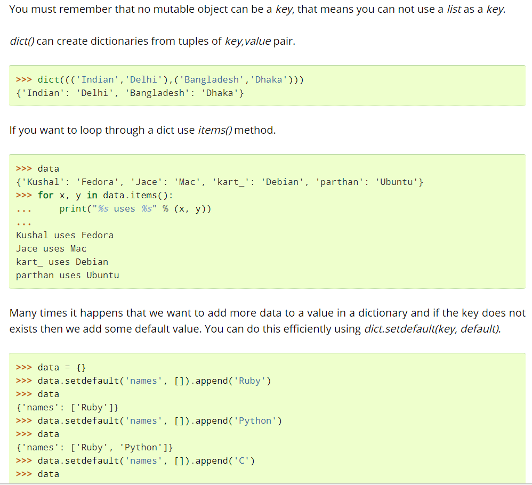

Slide 12
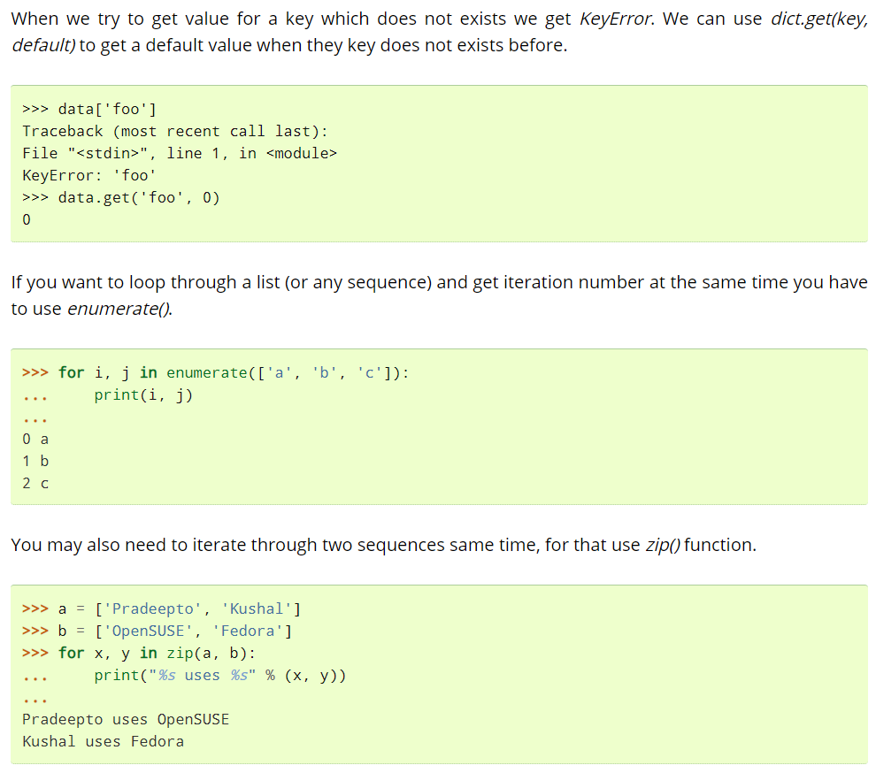

Slide 13
Strings
Methods of String
Manipulation of String
Palindrome program
Number of words in a sentence
Iterating all the characters in the string
Examples and Practice Questions

Slide 14
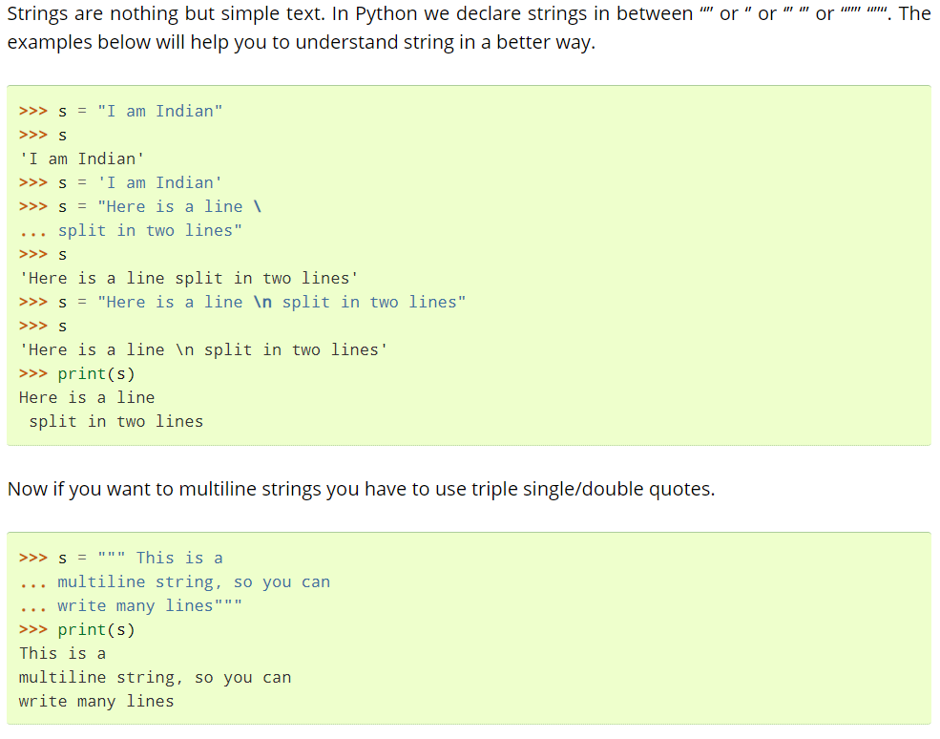

Slide 15
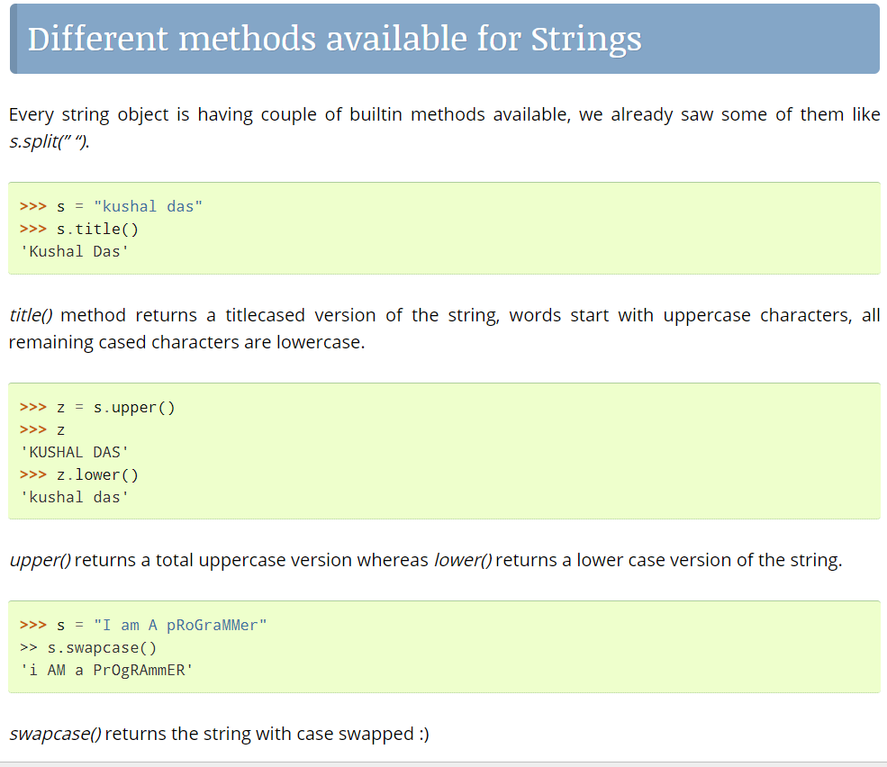

Slide 16
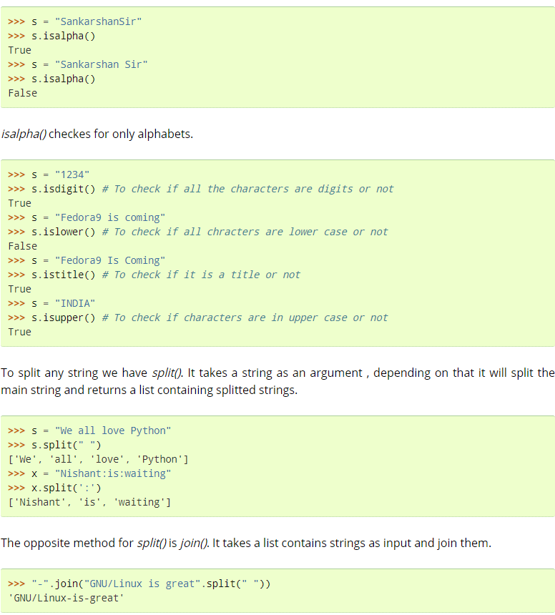

Slide 17
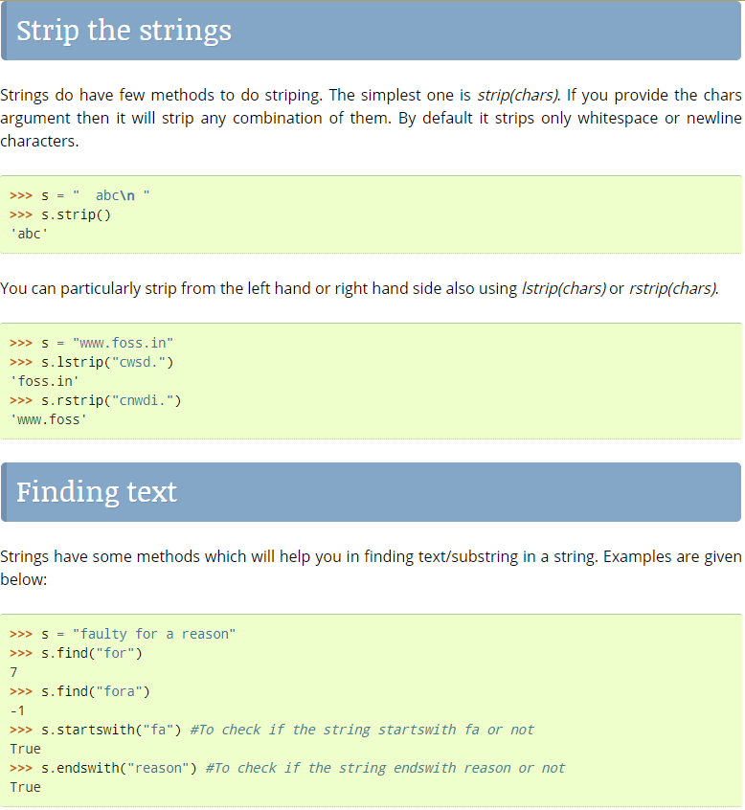

Slide 18
